Slide 1
phData AwesomeStuff.com Proposal

Slide 2
Agenda
Project Overview & Business Problem
Proposed Solution & Approach
Business Value & Outcomes
Project Phases & Timeline
Team & Resourcing
Estimated Pricing
Why phData & Next Steps
Notes:
Project Overview & Business Problem
Understand AwesomeStuff’s current pain points and goals
Proposed Solution & Approach
phData’s MLOps strategy to deploy and sustain ML models
Business Value & Outcomes
How the solution impacts KPIs, revenue, and operations
Project Phases & Timeline
A phased plan from foundation to full production
Team & Resourcing
Roles and responsibilities for successful execution
Estimated Pricing
High-level cost estimate by phase
Why phData & Next Steps
Our differentiators and how we get started

Slide 3
Project Overview/Business Problem
AwesomeStuff.com is a leading e-commerce platform offering a broad range of consumer products. They’ve trained a suite of machine learning models—recommendation engine, fraud detection, dynamic pricing, customer segmentation, and inventory optimization—but are struggling to deploy them reliably at scale.
Challenges include handling real-time traffic during peak demand, integrating with legacy systems, ensuring compliance (e.g., GDPR), and building a sustainable process for monitoring and retraining. They need a scalable MLOps foundation to operationalize ML and unlock business value.
Notes:
What we’re proposing isn’t just deployment—it’s strategic transformation. Our goal is to build a modern ML platform that empowers the business to get real-time value from these models continuously. We’ll use battle-tested MLOps patterns: containerized models, version control, CI/CD pipelines, observability, retraining workflows, and drift monitoring.
For latency-sensitive use cases like fraud detection or recs, we’ll focus on fast inference with streaming tools or model endpoints. For async tasks like segmentation, we’ll design efficient batch processing. All of it lives under a governed, compliant, and secure architecture—future-proofed for growth.

Slide 4
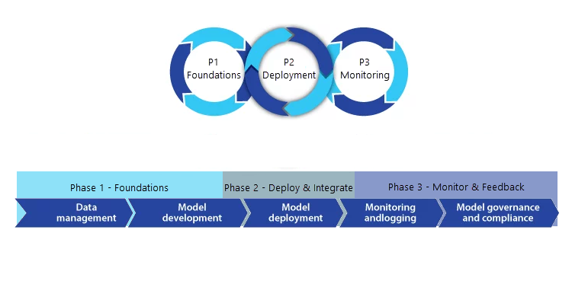
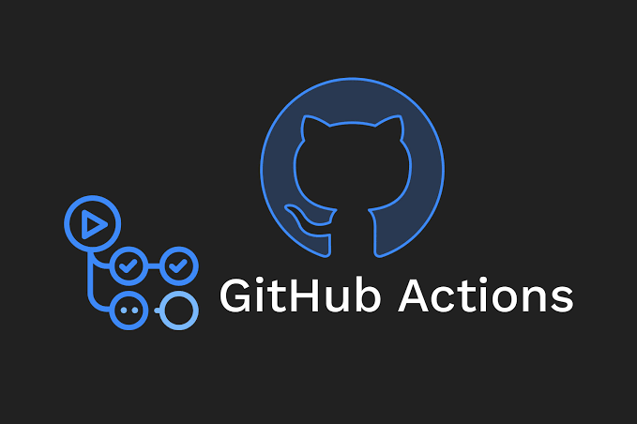



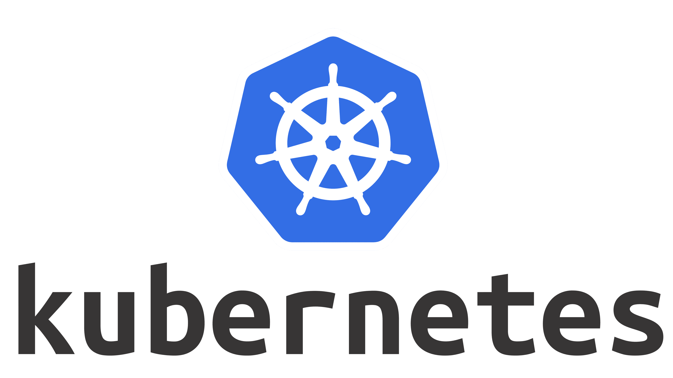


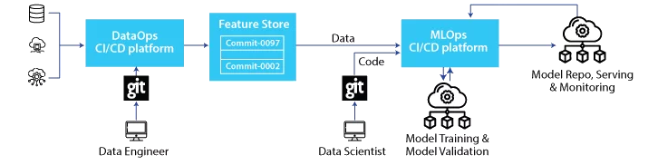
Approach to a successful AwesomeStuff.com project
Phase 1 – Foundations
Containerize all ML models using for consistent reproducibility and isolation.
Establish automated CI/CD pipelines via GitHub Actions, integrated with Git version-control.
Implement MLflow as the model registry to track, version, and promote production-ready models.
Phase 2 – Model Deployment & Integration
Serve real-time models (fraud, recommendations) using KServe with autoscaling and REST/gRPC endpoints.
Schedule batch inference pipelines (segmentation, inventory) using Apache Airflow.
Integrate model APIs directly into the e-commerce platform, CRM, and inventory backend via secured endpoints.
Phase 3 – Monitoring, Drift Detection, Retraining & Feedback
Monitor model performance and input/output drift using Prometheus + WhyLabs.
Configure automated alerts and audit logs for GDPR compliance and operational visibility.
Trigger retraining pipelines based on drift, performance thresholds, or scheduled cycles — executed via Airflow.
Notes:
Our approach is modular but unified. We start by packaging every model and versioning it in a model registry. From there, we set up a CI/CD pipeline that allows data scientists to ship new models with confidence, not chaos.
For high-speed use cases like fraud or recs, we deploy real-time endpoints with autoscaling. For others, we build batch pipelines that run nightly or weekly. All of this runs on top of a monitoring layer that tracks performance, detects drift, and raises alerts. The goal? Models that don’t just exist in prod—but stay useful and compliant over time.

Slide 5
Assumptions
Pre-trained ML models available and validated
Cloud infrastructure is provisioned and API-ready
Stakeholders are accessible for discovery & UAT
Kubernetes environment supports KServe, MLflow, Airflow
Team staffed with 5–6 core resources across phases
Resource allocations based on 40 hrs/week (FTEs)
Open-source tools adopted per phase (GitHub Actions, Prometheus, WhyLabs, etc.)
CI/CD, monitoring, and retraining pipelines are in-scope
Success includes full integration, monitoring, and client enablement
Notes:
What we’re proposing isn’t just deployment—it’s strategic transformation. Our goal is to build a modern ML platform that empowers the business to get real-time value from these models continuously. We’ll use battle-tested MLOps patterns: containerized models, version control, CI/CD pipelines, observability, retraining workflows, and drift monitoring.
For latency-sensitive use cases like fraud detection or recs, we’ll focus on fast inference with streaming tools or model endpoints. For async tasks like segmentation, we’ll design efficient batch processing. All of it lives under a governed, compliant, and secure architecture—future-proofed for growth.

Slide 6
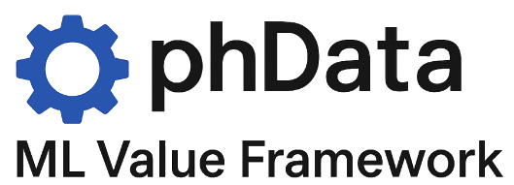
Business Value – Real Outcomes from Real ML
ML Model | Objective | Key KPI(s) Improved | Framework Support
Recommendation | Increase conversion & AOV | Conversion Rate, Avg Order | Real-time model serving, retraining loop
Fraud Detection | Prevent transaction loss | Chargeback Rate, Loss Ratio | Low-latency inference, drift monitoring
Inventory Forecast | Reduce waste, increase fulfillment | Stockouts, Inventory Cost | Batch inference, retrainable pipeline
Segmentation | Optimize campaign targeting | ROAS, Retention Rate | Segment lifecycle mgmt, drift detection
Dynamic Pricing | Improve margin & competitiveness | Unit Margin, Price Positioning | Scheduled pricing updates, A/B test infra
Notes:
Objective: Establish a secure, scalable, and automated foundation for machine learning operations. This is our phData ML Value Framework — it ensures every model you deploy maps directly to a business KPI and continues delivering value through automated governance and feedback loops. Let me walk you through the real business impact we’re unlocking.
Every model AwesomeStuff built solves a core operational or revenue problem.
But without a platform behind them, they remain experiments. With phData’s Framework deployment strategy, these models become real-time engines driving fraud prevention, personalization, inventory precision, and pricing optimization — all tied to measurable KPIs.
And critically, they’ll stay performant and compliant over time. This is how we shift from isolated data science projects… to business transformation.

Slide 7
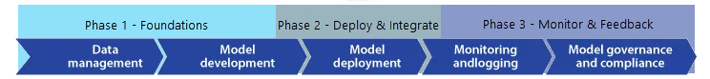
Phase 1 – Foundations
Key Outcomes
Objective: Establish the secure, scalable, and reproducible foundation for AwesomeStuff’s ML systems, enabling rapid, confident deployment to production environments.
Containerized Model Delivery: Package models using Docker to ensure reproducibility across dev, stage and prod environments.
Automated CI/CD for Models: Deploy GitHub Actions pipelines for model versioning, promotion, and rollback.
ML Lifecycle Management: Stand up MLflow for model registration, lineage tracking, and controlled promotion into production.
Feature Store Strategy Finalized: Use Feast to support online/offline parity and prevent data leakage during inference.
Security Controls & Auditability: Apply IAM role-based access, secrets management, and log audit trail mechanisms from day one.
Pre-Production Integration: Validate full system integration via a test environment that mirrors the e-commerce platform, CRM, and inventory stack.
Notes:
In Phase 1, we’re not just building infra — we’re operationalizing machine learning as a controlled, repeatable practice.
We ensure every model is portable (via Containerization), trackable (via MLflow), and deployable via CI/CD pipelines that your team can manage.
Feature data is governed through Feast, and everything is deployed into a test mirror of production — allowing seamless API and system integration validation before customer-facing impact.
We also harden the environment with IAM, secret handling, and audit controls — because ML in production isn’t just about speed; it’s about trust.

Slide 8
Phase 2 - Model Deployment & Integration
Key Outcomes
Objective: Enable scalable, low-latency model serving for real-time and batch use cases, fully integrated into business-critical systems.
Real-Time Inference with KServe: Deploy latency-sensitive models (e.g., fraud detection, recommendations) as auto-scaled REST/gRPC endpoints using KServe on Kubernetes.
Scheduled Batch Inference with Airflow: Run models like inventory forecasting and customer segmentation on a defined schedule using Apache Airflow DAGs.
System Integration Across Stacks: Integrate model outputs into AwesomeStuff’s e-commerce platform, CRM, and inventory system via secure, governed APIs.
Online/Offline Feature Parity: Maintain consistent feature computation between training and production environments using Feast.
Inference-Level Monitoring: Capture latency, throughput, error rates, and resource metrics via Prometheus and Grafana.
Notes:
This is the activation phase — models go live, but under controlled, observable conditions.
We deploy fraud detection and recommendation models behind scalable endpoints via KServe, delivering real-time predictions during checkout or browsing.
For segmentation and inventory, Airflow handles batch scheduling with defined SLAs.
Every inference call is observable. We track latency, monitor error rates, and validate feature integrity across training vs production.
And all of this integrates directly with business systems — marketing platforms, inventory engines, and the e-commerce stack — turning data science outputs into operational inputs.

Slide 9
Phase 3 – Monitoring, Drift Detection & Feedback
Key Outcomes
Objective: Enable scalable, low-latency model serving for real-time and batch use cases, fully integrated into business-critical systems.
Model Performance Monitoring: Track accuracy, precision, recall, and F1 in production to detect degradation.
Data Drift Detection with WhyLabs: Monitor inputs and outputs for schema or concept drift using WhyLabs.
Alerting and Audit Logging: Set alerts for anomalies; log events for GDPR and internal compliance.
Automated Retraining Pipelines: Use Airflow to trigger retraining on drift, performance drop, or schedule.
Shadow Deployment and A/B Testing: Validate new models using shadow mode and A/B strategies before cutover.
Notes:
The day a model goes live is the best it will ever be — after that, it’s decay. So, in Phase 3, we build the guardrails that catch that decay early.
We implement monitoring for both business KPIs and data quality — so if inputs drift or outputs misbehave, we know. We wire up alerts, logs for audits, and retraining pipelines to course-correct fast. This is how we make the platform durable, not just functional.

Slide 10

Our Team of Professionals
04 ML DevOps Architect
Builds CI/CD infrastructure, manages container orchestration (e.g., Kubernetes), configures observability.
03 Data Engineer
Ensures clean data flow across systems, manages feature stores, batch/stream pipelines, and data security.
02 Machine Learning Engineer
Implements model packaging, deployment pipelines, inference services, and integrations with internal systems.
01 Machine Learning Architect
Designs the overall MLOps solution architecture, ensures scalability, security, and alignment with business goals.
06 Project Manager
Coordinates timelines, deliverables, and communication across technical and business stakeholders.
05 Tech Business Analyst
Learns your business, connects ML outputs to BI dashboards, reporting systems, and executive insights for marketing and ops teams.
07 Client Enablement Lead
Focuses on ensuring client users are fully equipped to leverage the value of a product or service, leading to increased adoption and increased success.
Notes:
We bring a cross-functional team to keep the build fast and the handoffs clean.
The ML Architect leads the solution design. The MLEs do the heavy lifting on model deployment. Data Engineers handle ingest, features, and pipeline orchestration. DevOps wires the CI/CD and monitors the system.
This team is lean but battle-tested. And it scales as needed—if AwesomeStuff wants to expand the scope, we can ramp up additional resources without slowing velocity.

Slide 11
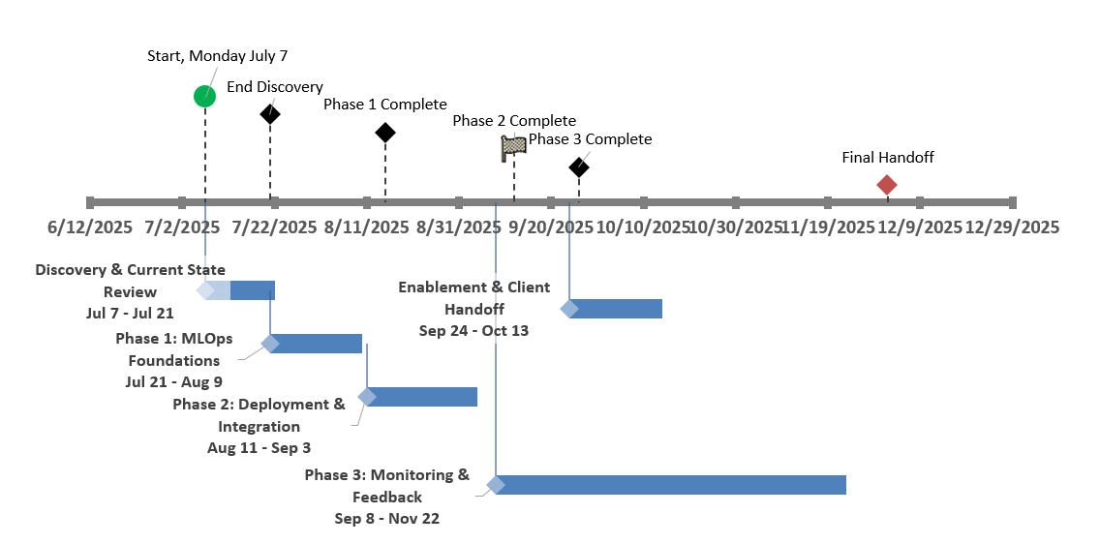
Project Timeline – High Level

Slide 12
Project Pricing - Estimation
Time & Materials
Phase | Approximate Duration | Pricing
Discovery & Current State Review | 2 | $ 51,500.00
Phase 1: MLOps Foundations | 3 | $ 127,800.00
Phase 2: Deployment & Integration | 4 | $ 161,800.00
Phase 3: Monitoring & Feedback | 6 | $ 217,800.00
Enablement & Client Handoff | 8 | $ 167,200.00
Project Total | 23 Weeks | $726,100.00
Notes:
10% Contingency
| Role | Suggested Rate (Hourly) | Weekly Hours | Notes |
| -------------------------- | ----------------------- | ------------ | ----------------------------------------- |
| **ML Architect** | $225 | 40 | Solution architecture, business alignment |
| **ML Engineer** | $200 | 40 | Model deployment, inference integration |
| **Data Engineer** | $175 | 40 | Pipelines, feature stores, data readiness |
| **ML DevOps Architect** | $200 | 40 | CI/CD, Kubernetes, observability |
| **Tech Business Analyst** | $150 | 40 | Connect ML output to BI & reporting |
| **Project Manager** | $150 | 40 | Coordination, stakeholder updates |
| **Client Enablement Lead** | $160 | 40 | Training, onboarding, client success |

Slide 13

Why phData
We specialize in AI and data applications, from conception to production, that drive real-world business value. Our global delivery team partners with the world’s top brands to execute data initiatives in artificial intelligence, data engineering, applications, analytics, and 24/7 Elastic Operations for cloud platforms.
phData's comprehensive services, industry recognition, innovative solutions, global presence, and commitment to both client and employee success make them a compelling choice for any organization seeking to harness the power of data.
Notes:
We don’t use AI to avoid thinking. We used it to think faster — and sharper. That’s the future of true leadership.
This deck is a case study in how a Principal Architect should think with AI — collaborative, efficient, and outcome-driven.

Slide 14


Next Steps
To maintain momentum and ensure a smooth transition into execution, the following steps are recommended immediately following this review. These are focused on operational readiness, eliminating blockers, and setting up for measurable success in Phase 1.
Collect Existing Artifacts & Documentation
Confirm Team & Execution Plan.
Ramp to Success
Provision Environments & Grant Access.

